Slide 1
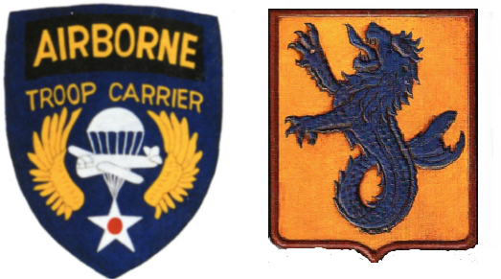
Neptune
Boston and Freeport
June 6 & 7 1944

Slide 2
316th Troop Carrier Group

Slide 3
Part of message by General Dwight D. Ei­senhower
Sailors, Soldiers and Airmen of the Allied Expeditionary Force!
You are about to embark upon the Great Crusade, toward which we have striven these many months. The eyes of the world are upon you. The hopes and prayers of liberty-loving people everywhere march with you ....
Your task will not be an easy one. Your enemy is well trained, well equipped and battle-hardened. He will fight savagely ....
I have full confidence in your courage, devotion to duty and skill. in battle. We will accept nothing less than full Victory.
Good Luck! And let us all beseech the blessing of Almighty God upon this great and noble undertaking.

Slide 4
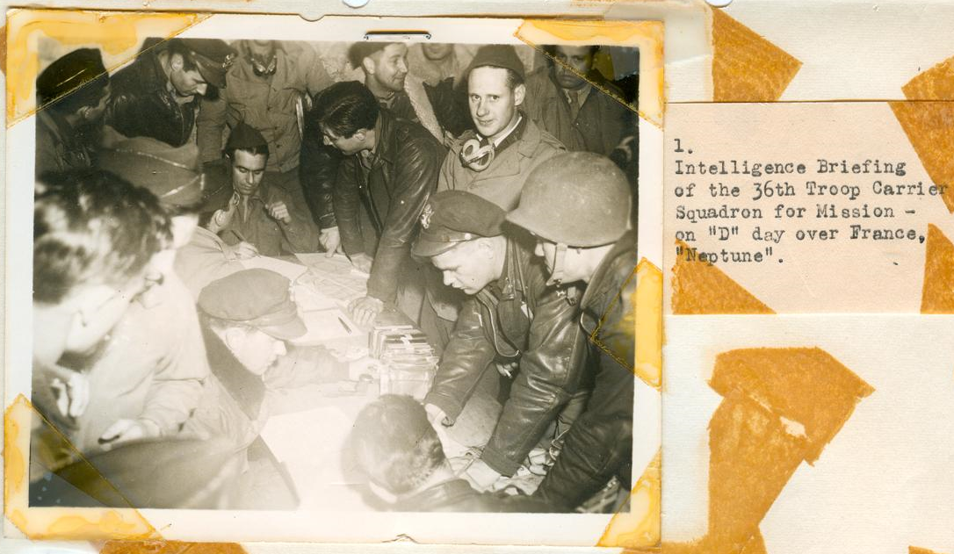

Slide 5
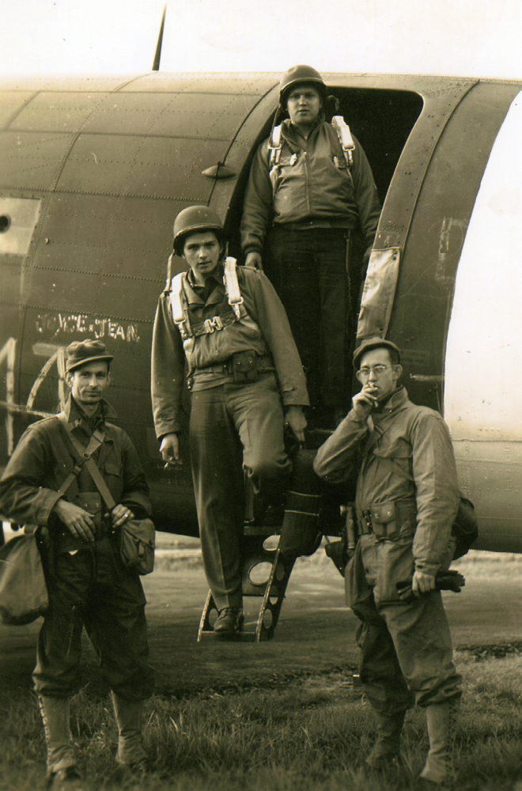

Slide 6
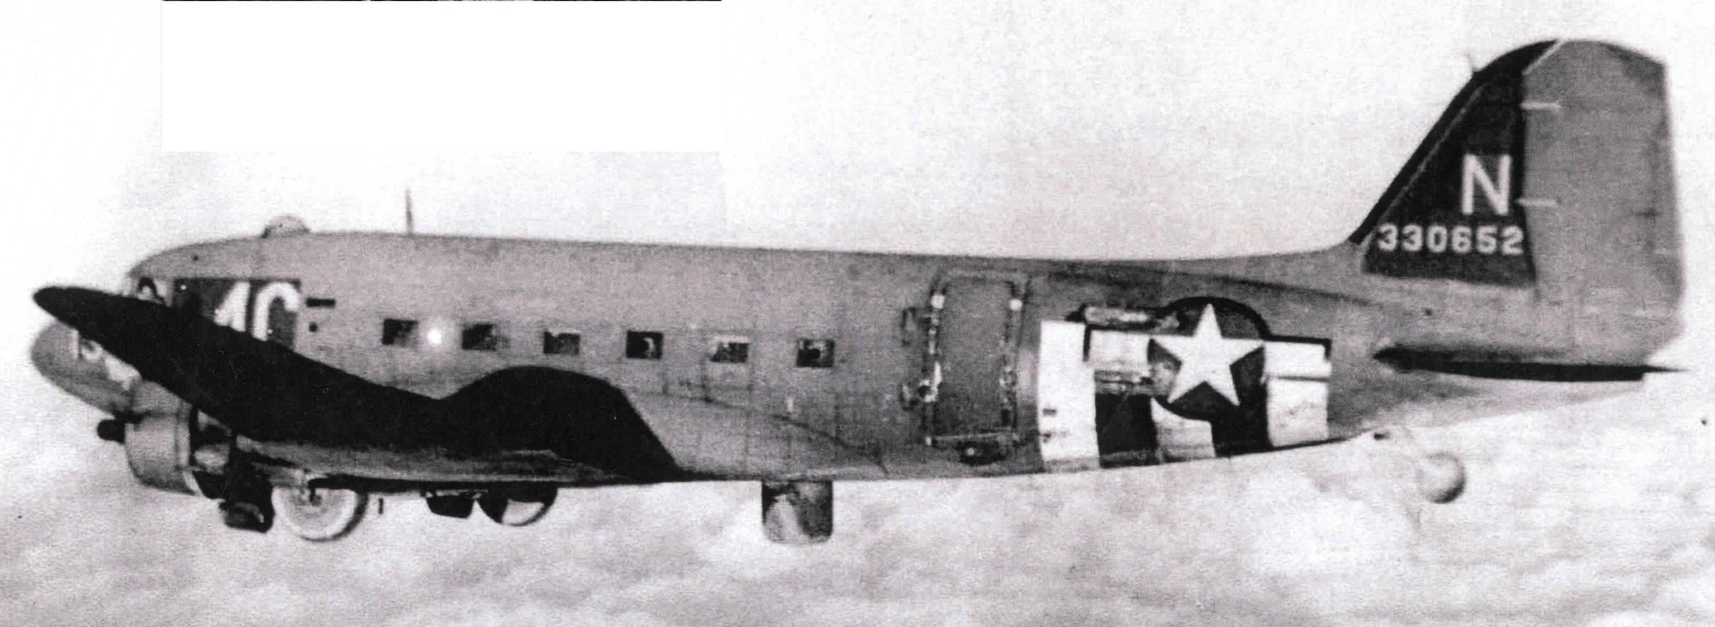

Slide 7
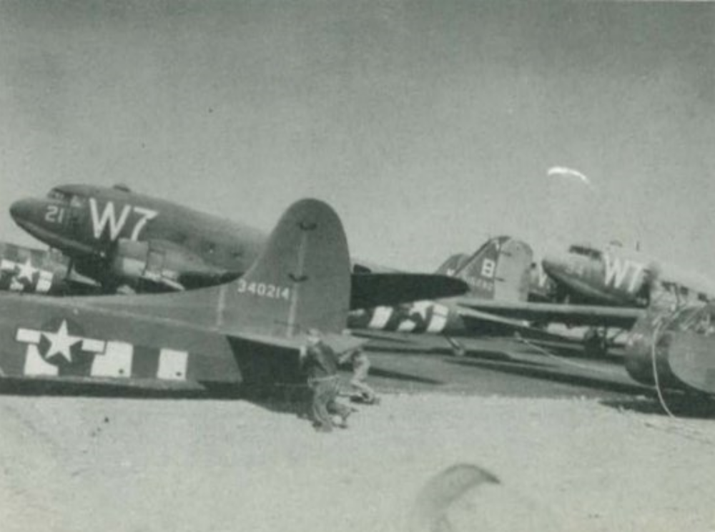

Slide 8
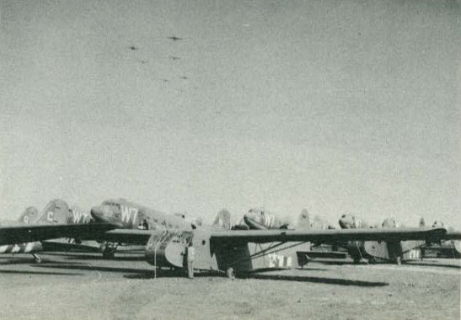

Slide 9
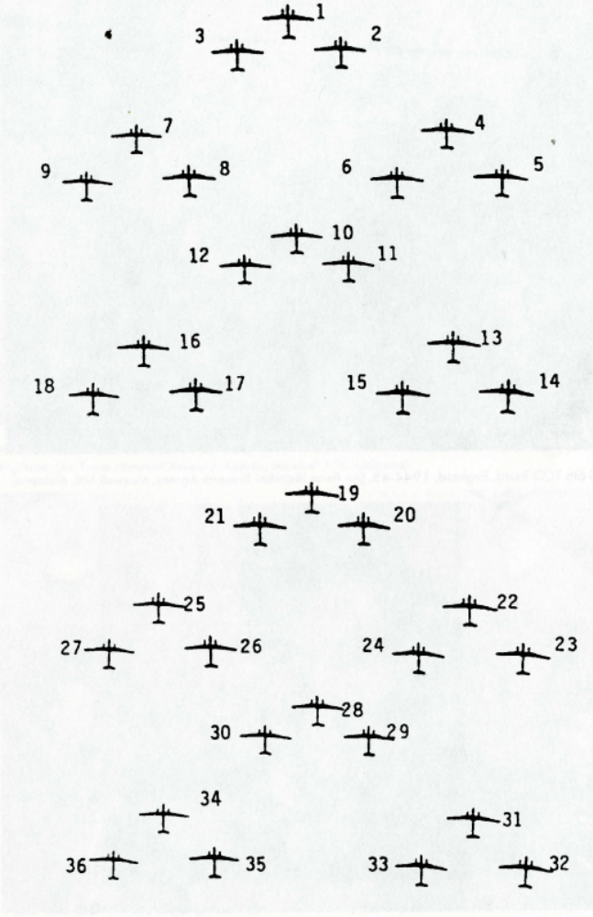
Typical flight serials

Slide 10
Neptune Boston
The order specified that the mission code for the 52nd TCW was NEPTUNE­BOSTON. The 316th TCG would fly Serial Numbers 17 and 18, each with 36 planes. Its target was DZ "O" just slightly northwest of Ste. Mere Eglise in Normandy. The first 36 planes were to be chalk-marked: 1-36, and would drop the 2nd Battalion, 505th PIR. The other 36 planes, chalk-marked 37-72, would drop the 3rd Battalion.

Slide 11
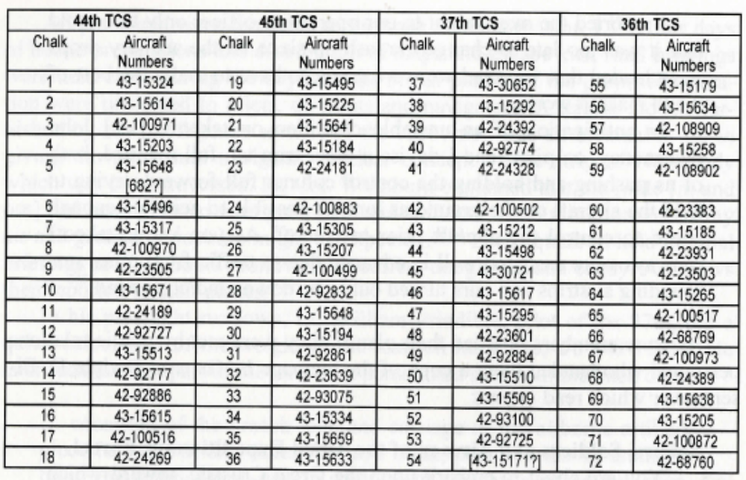

Slide 12
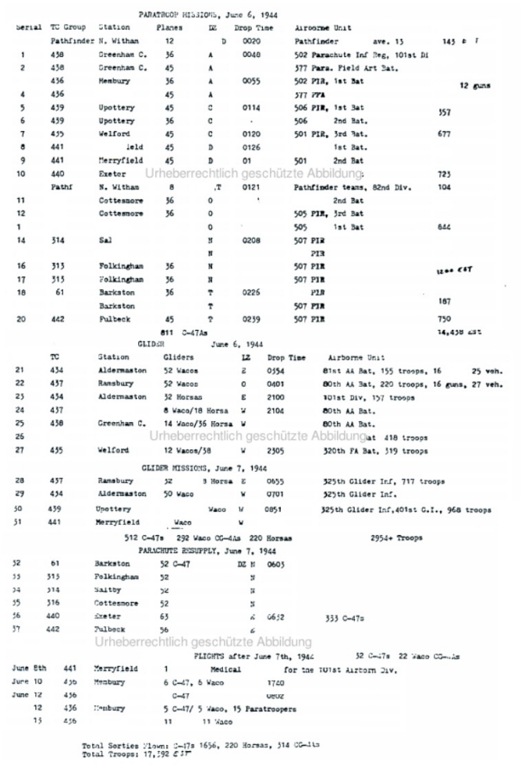

Slide 13
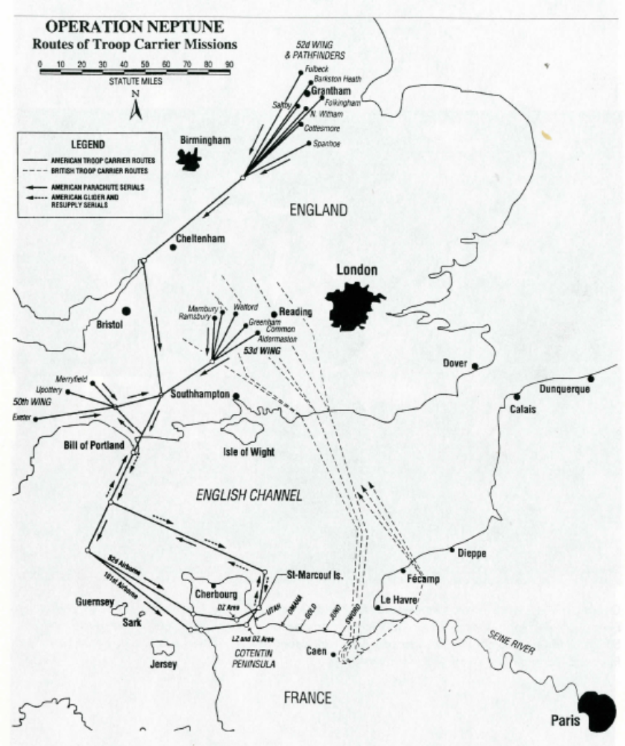

Slide 14
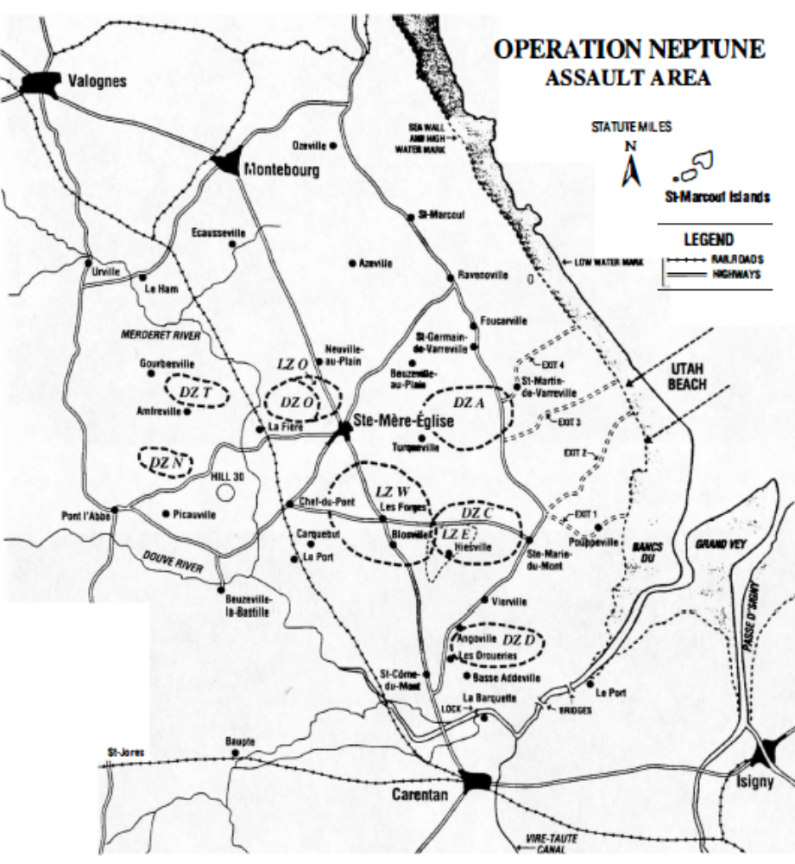

Slide 15
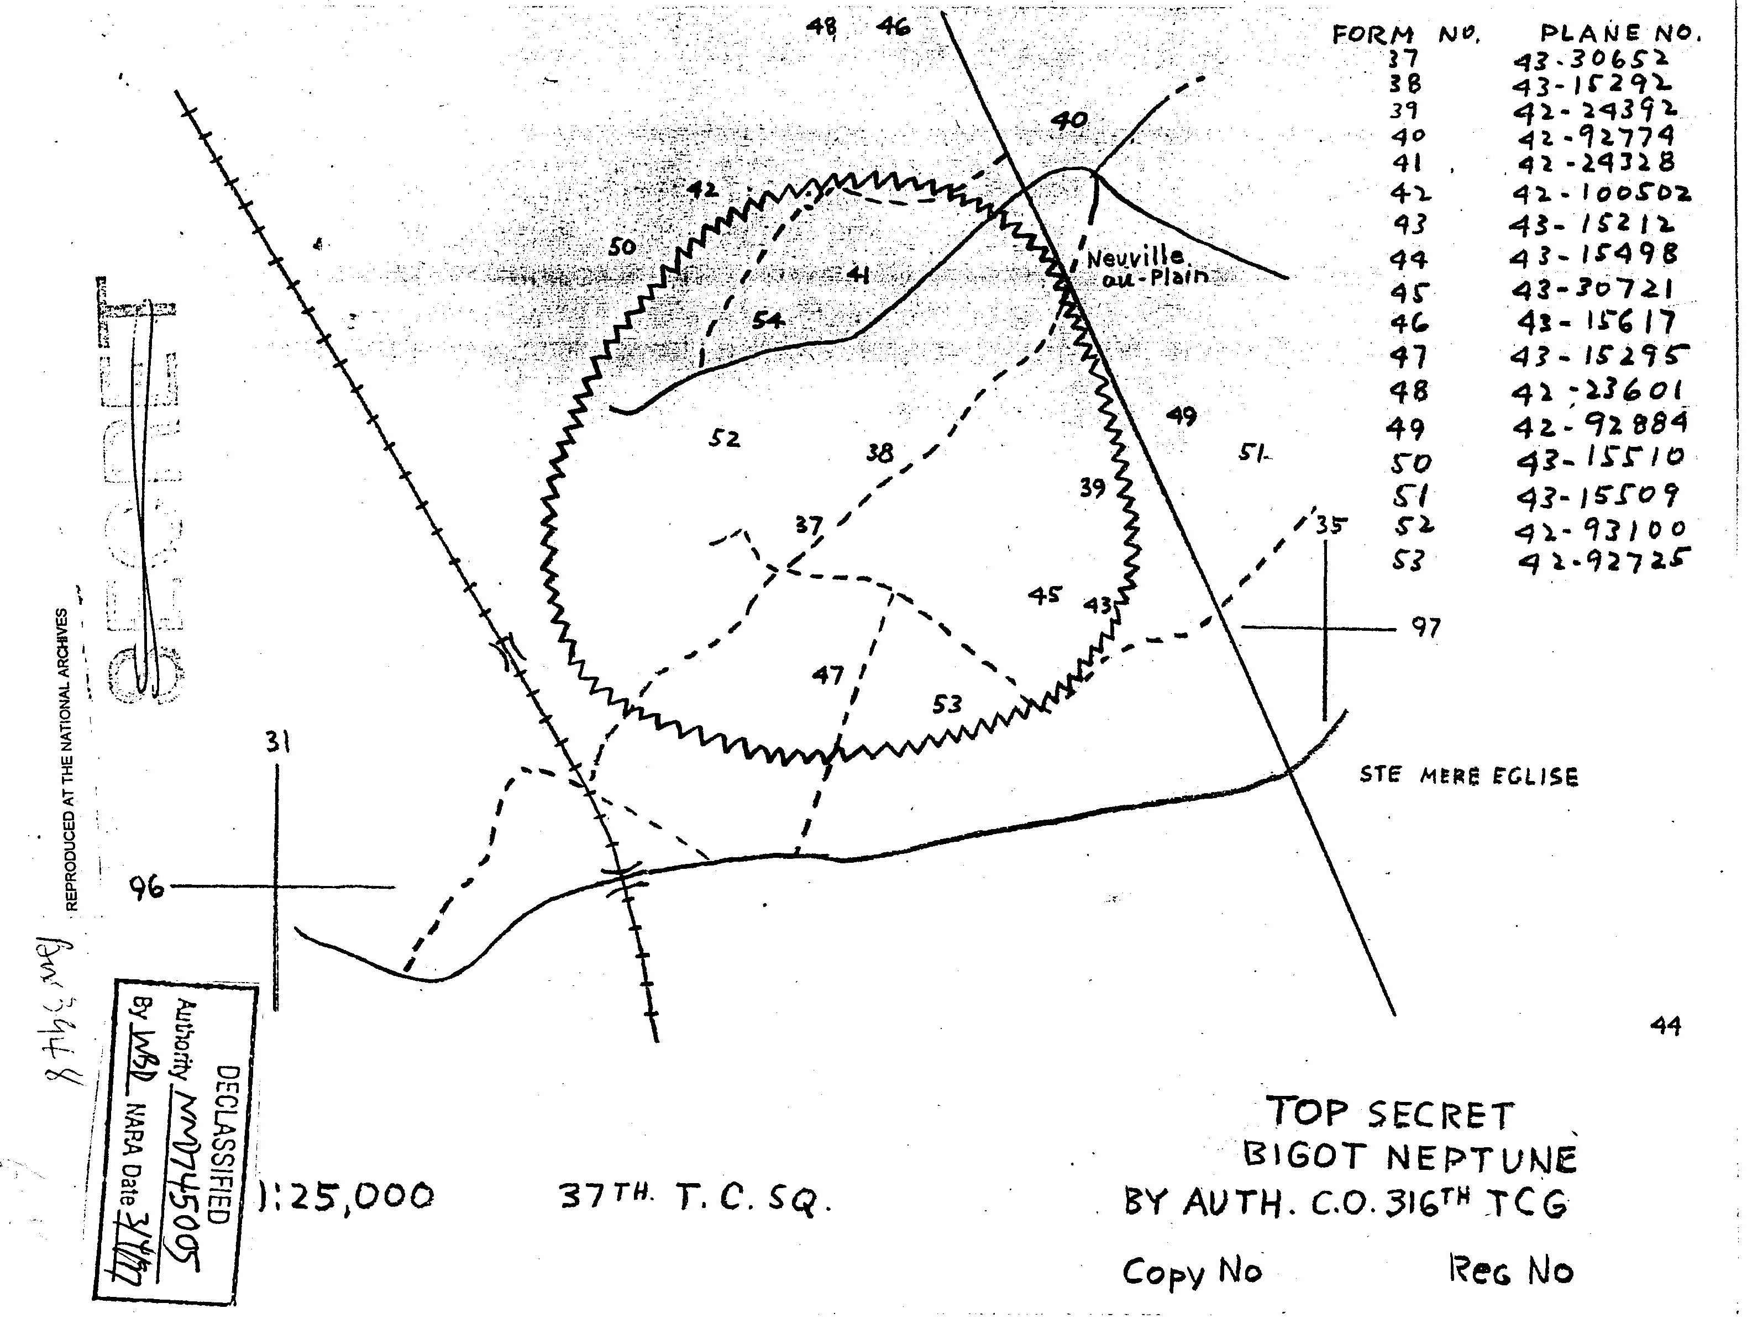

Slide 16
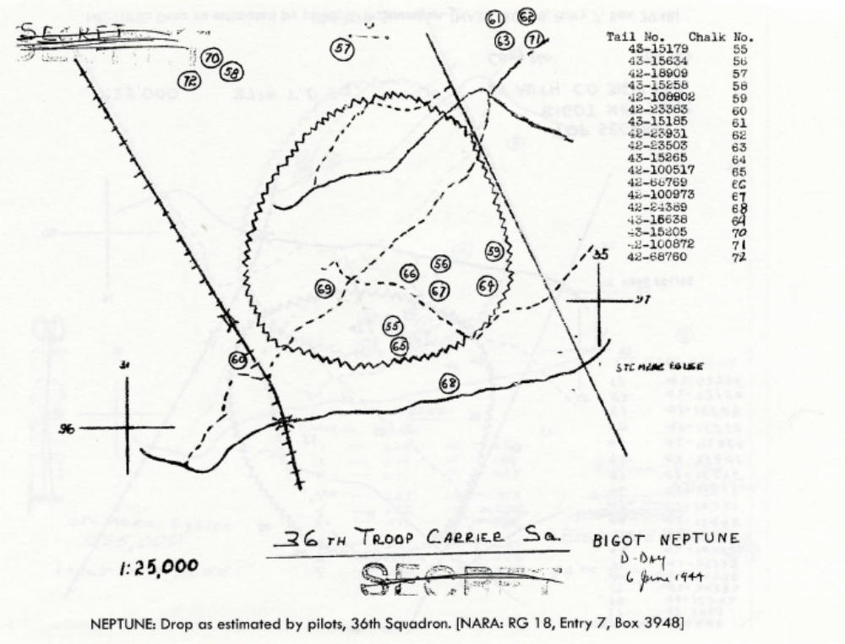

Slide 17
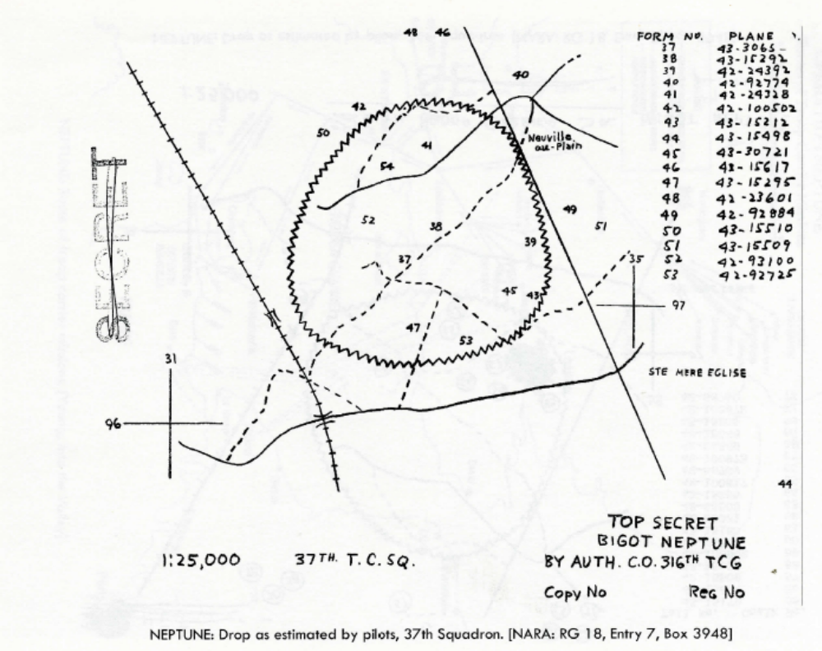

Slide 18
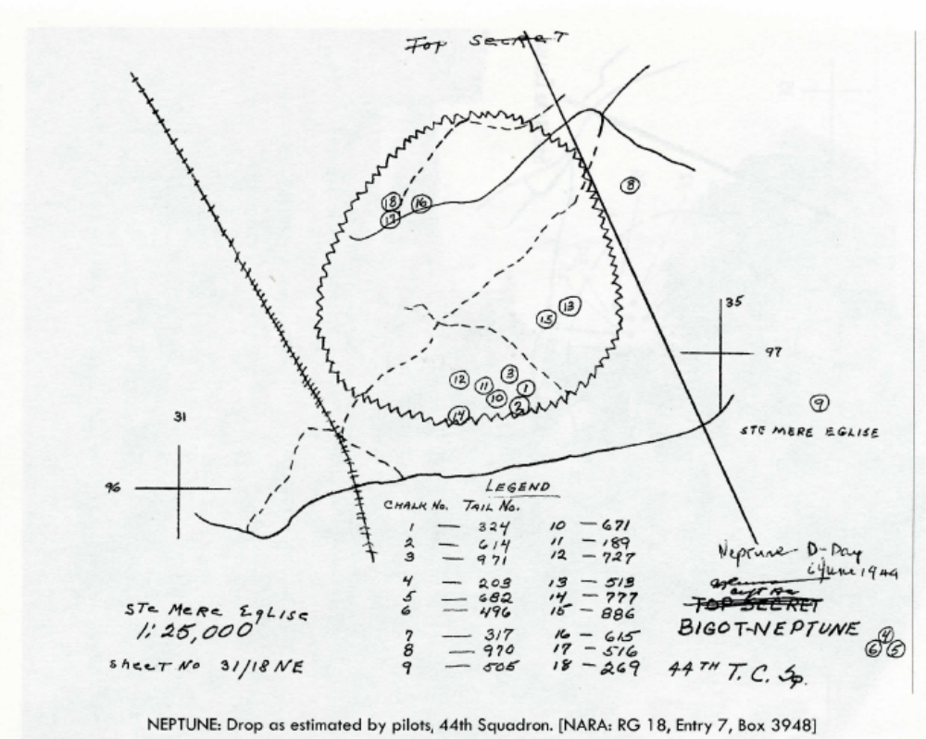

Slide 19
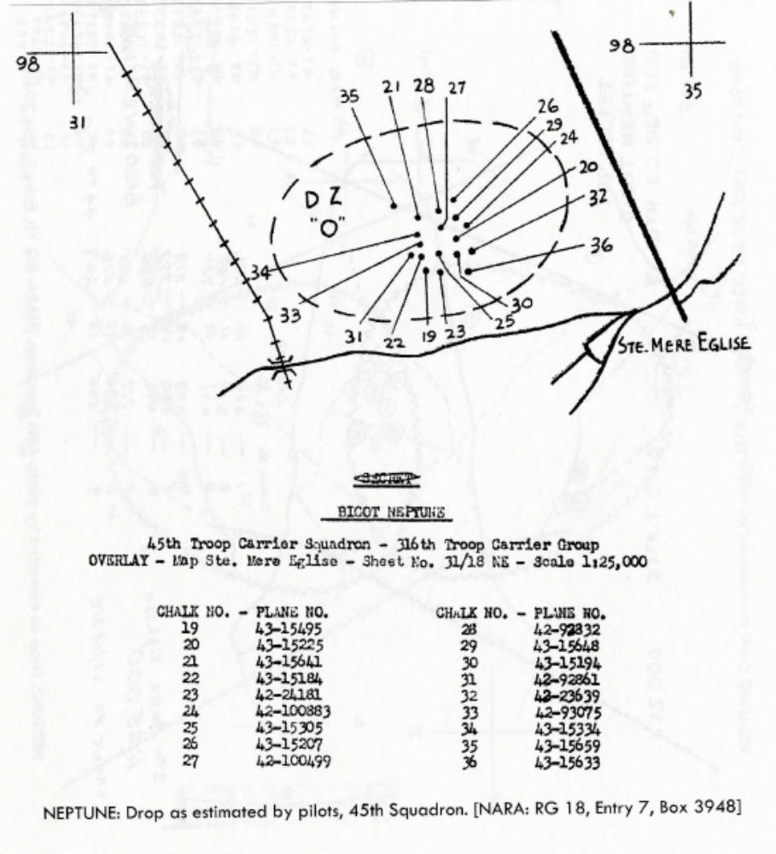

Slide 20
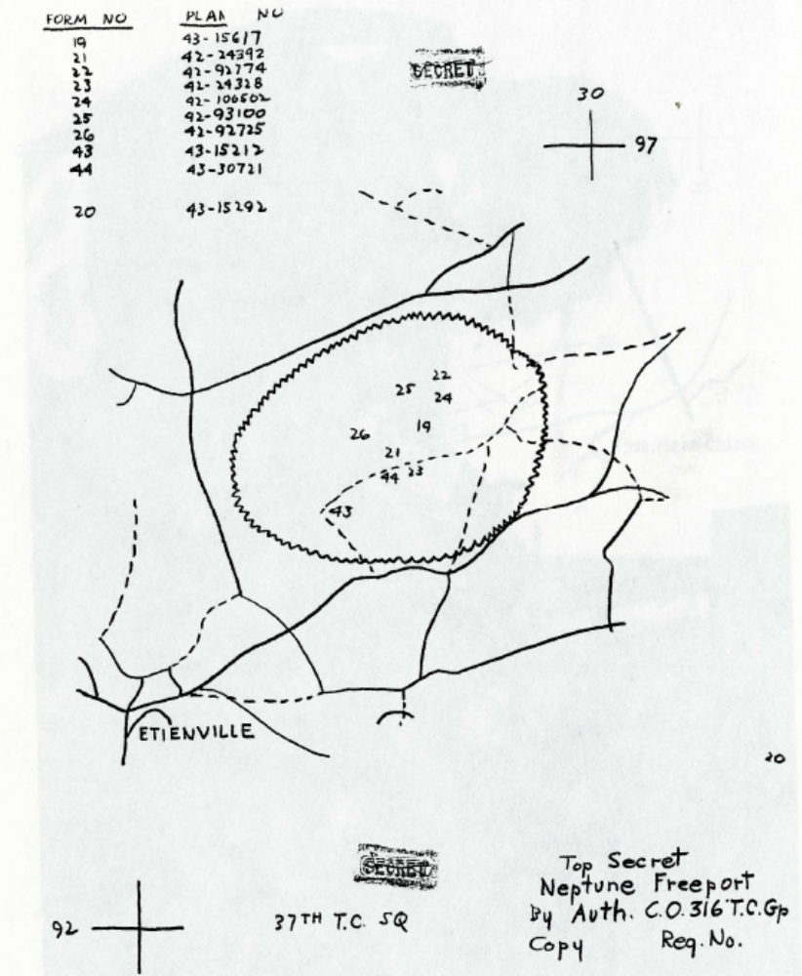

Slide 21
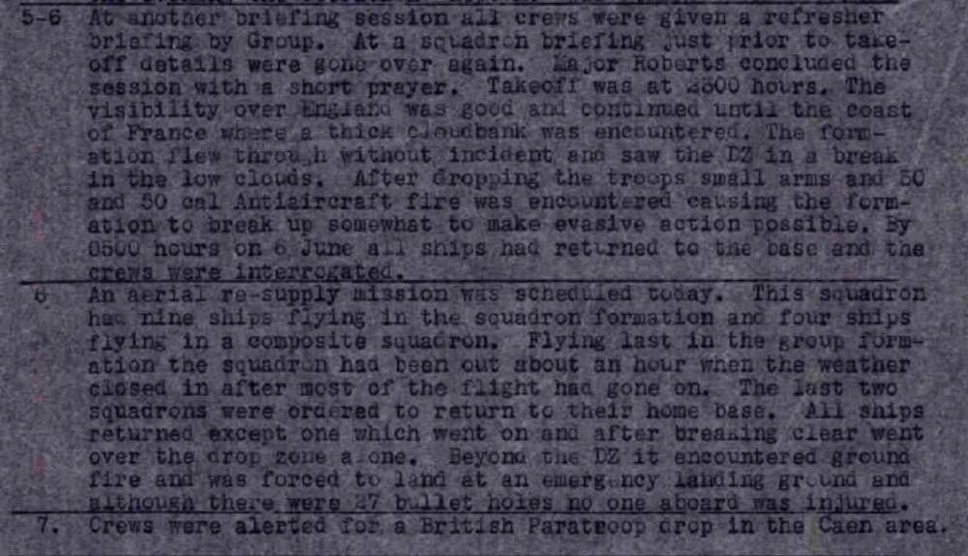
36th Troop Carrier Squadron

Slide 22
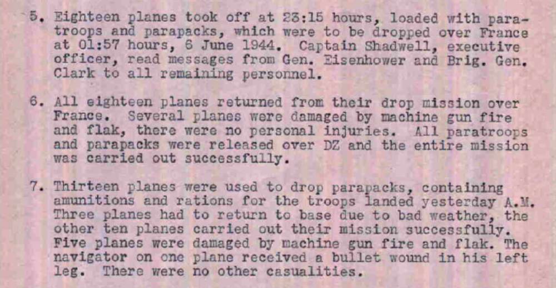
37th TCS History June 1944

Slide 23
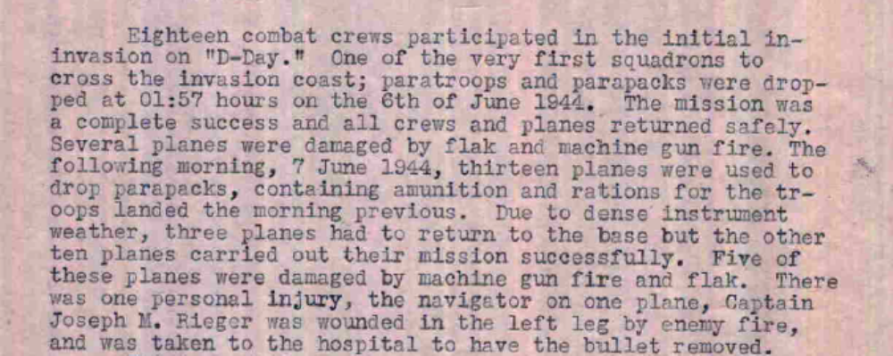
37th TCS History June 1944

Slide 24
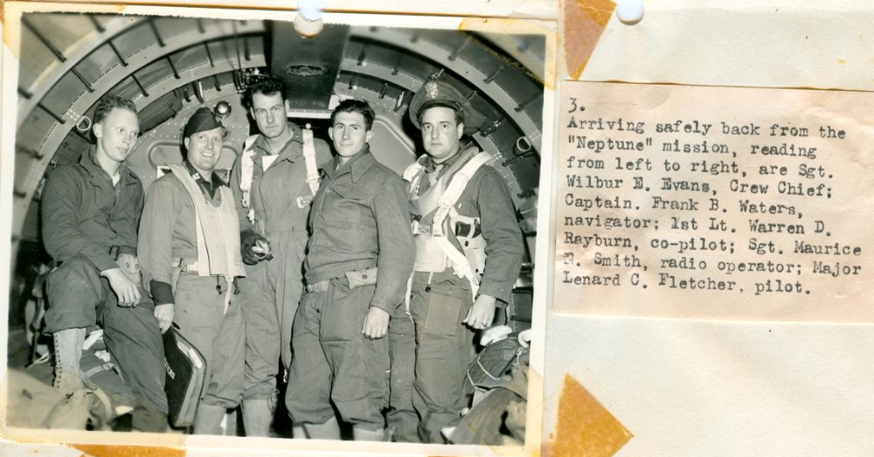

Slide 25
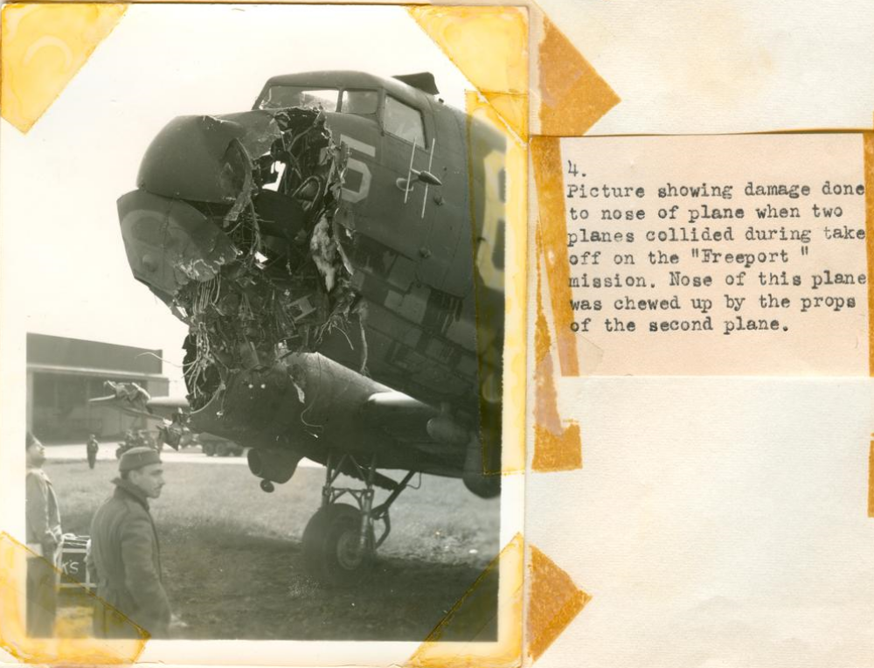

Slide 26
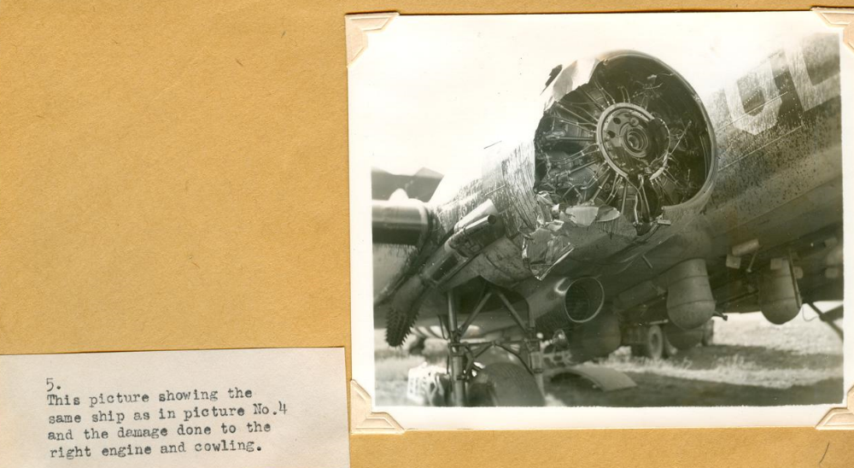

Slide 27
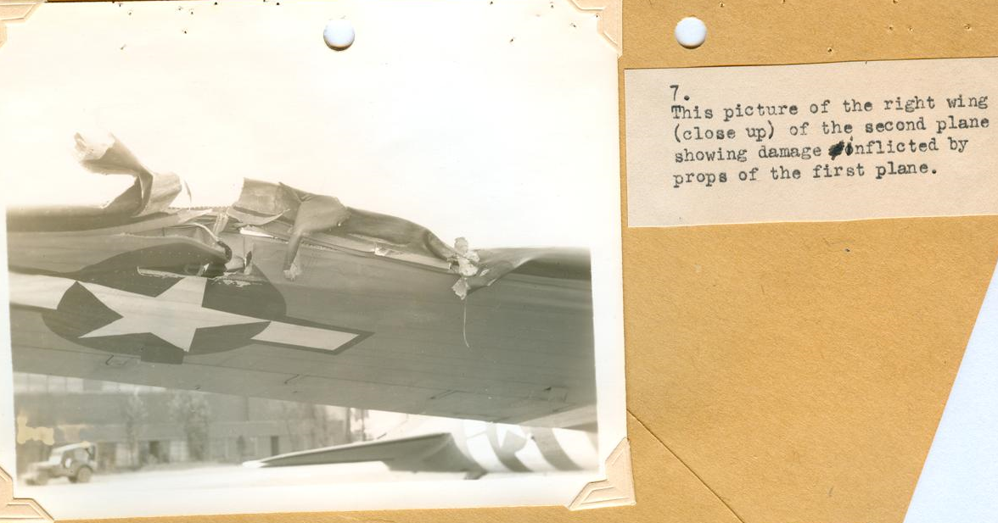
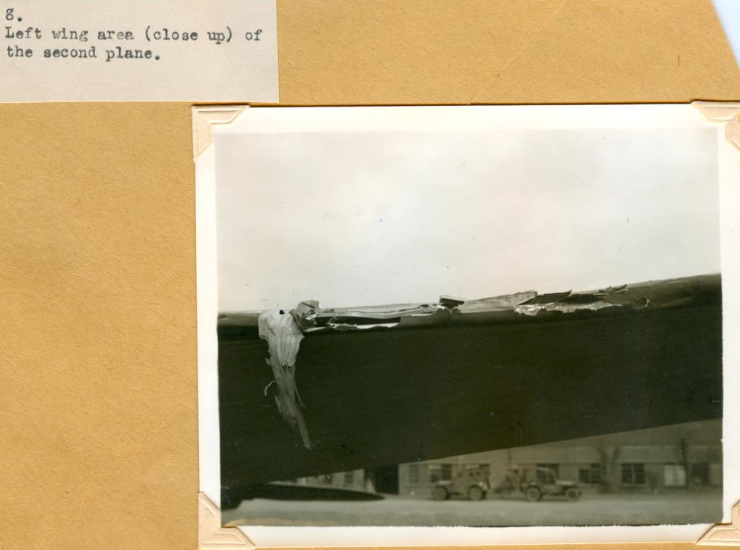

Slide 28
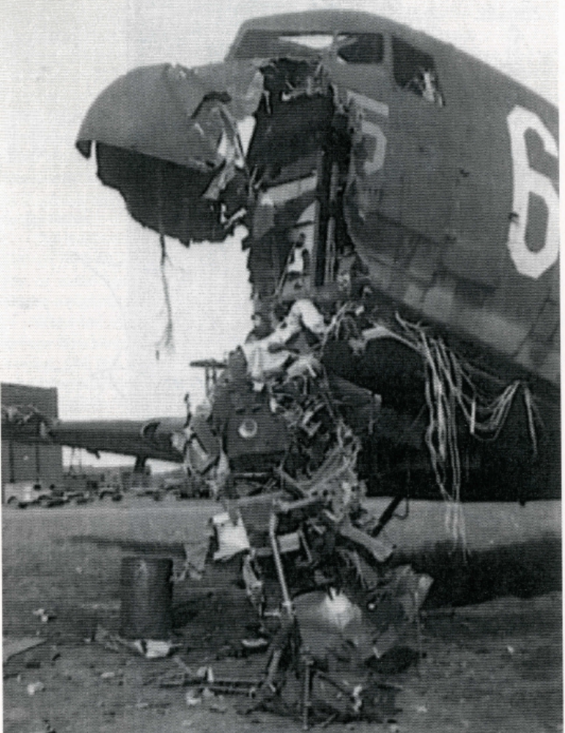
Death of Lt. Heinlein, Cottesmore England June 7, 1944

Slide 29
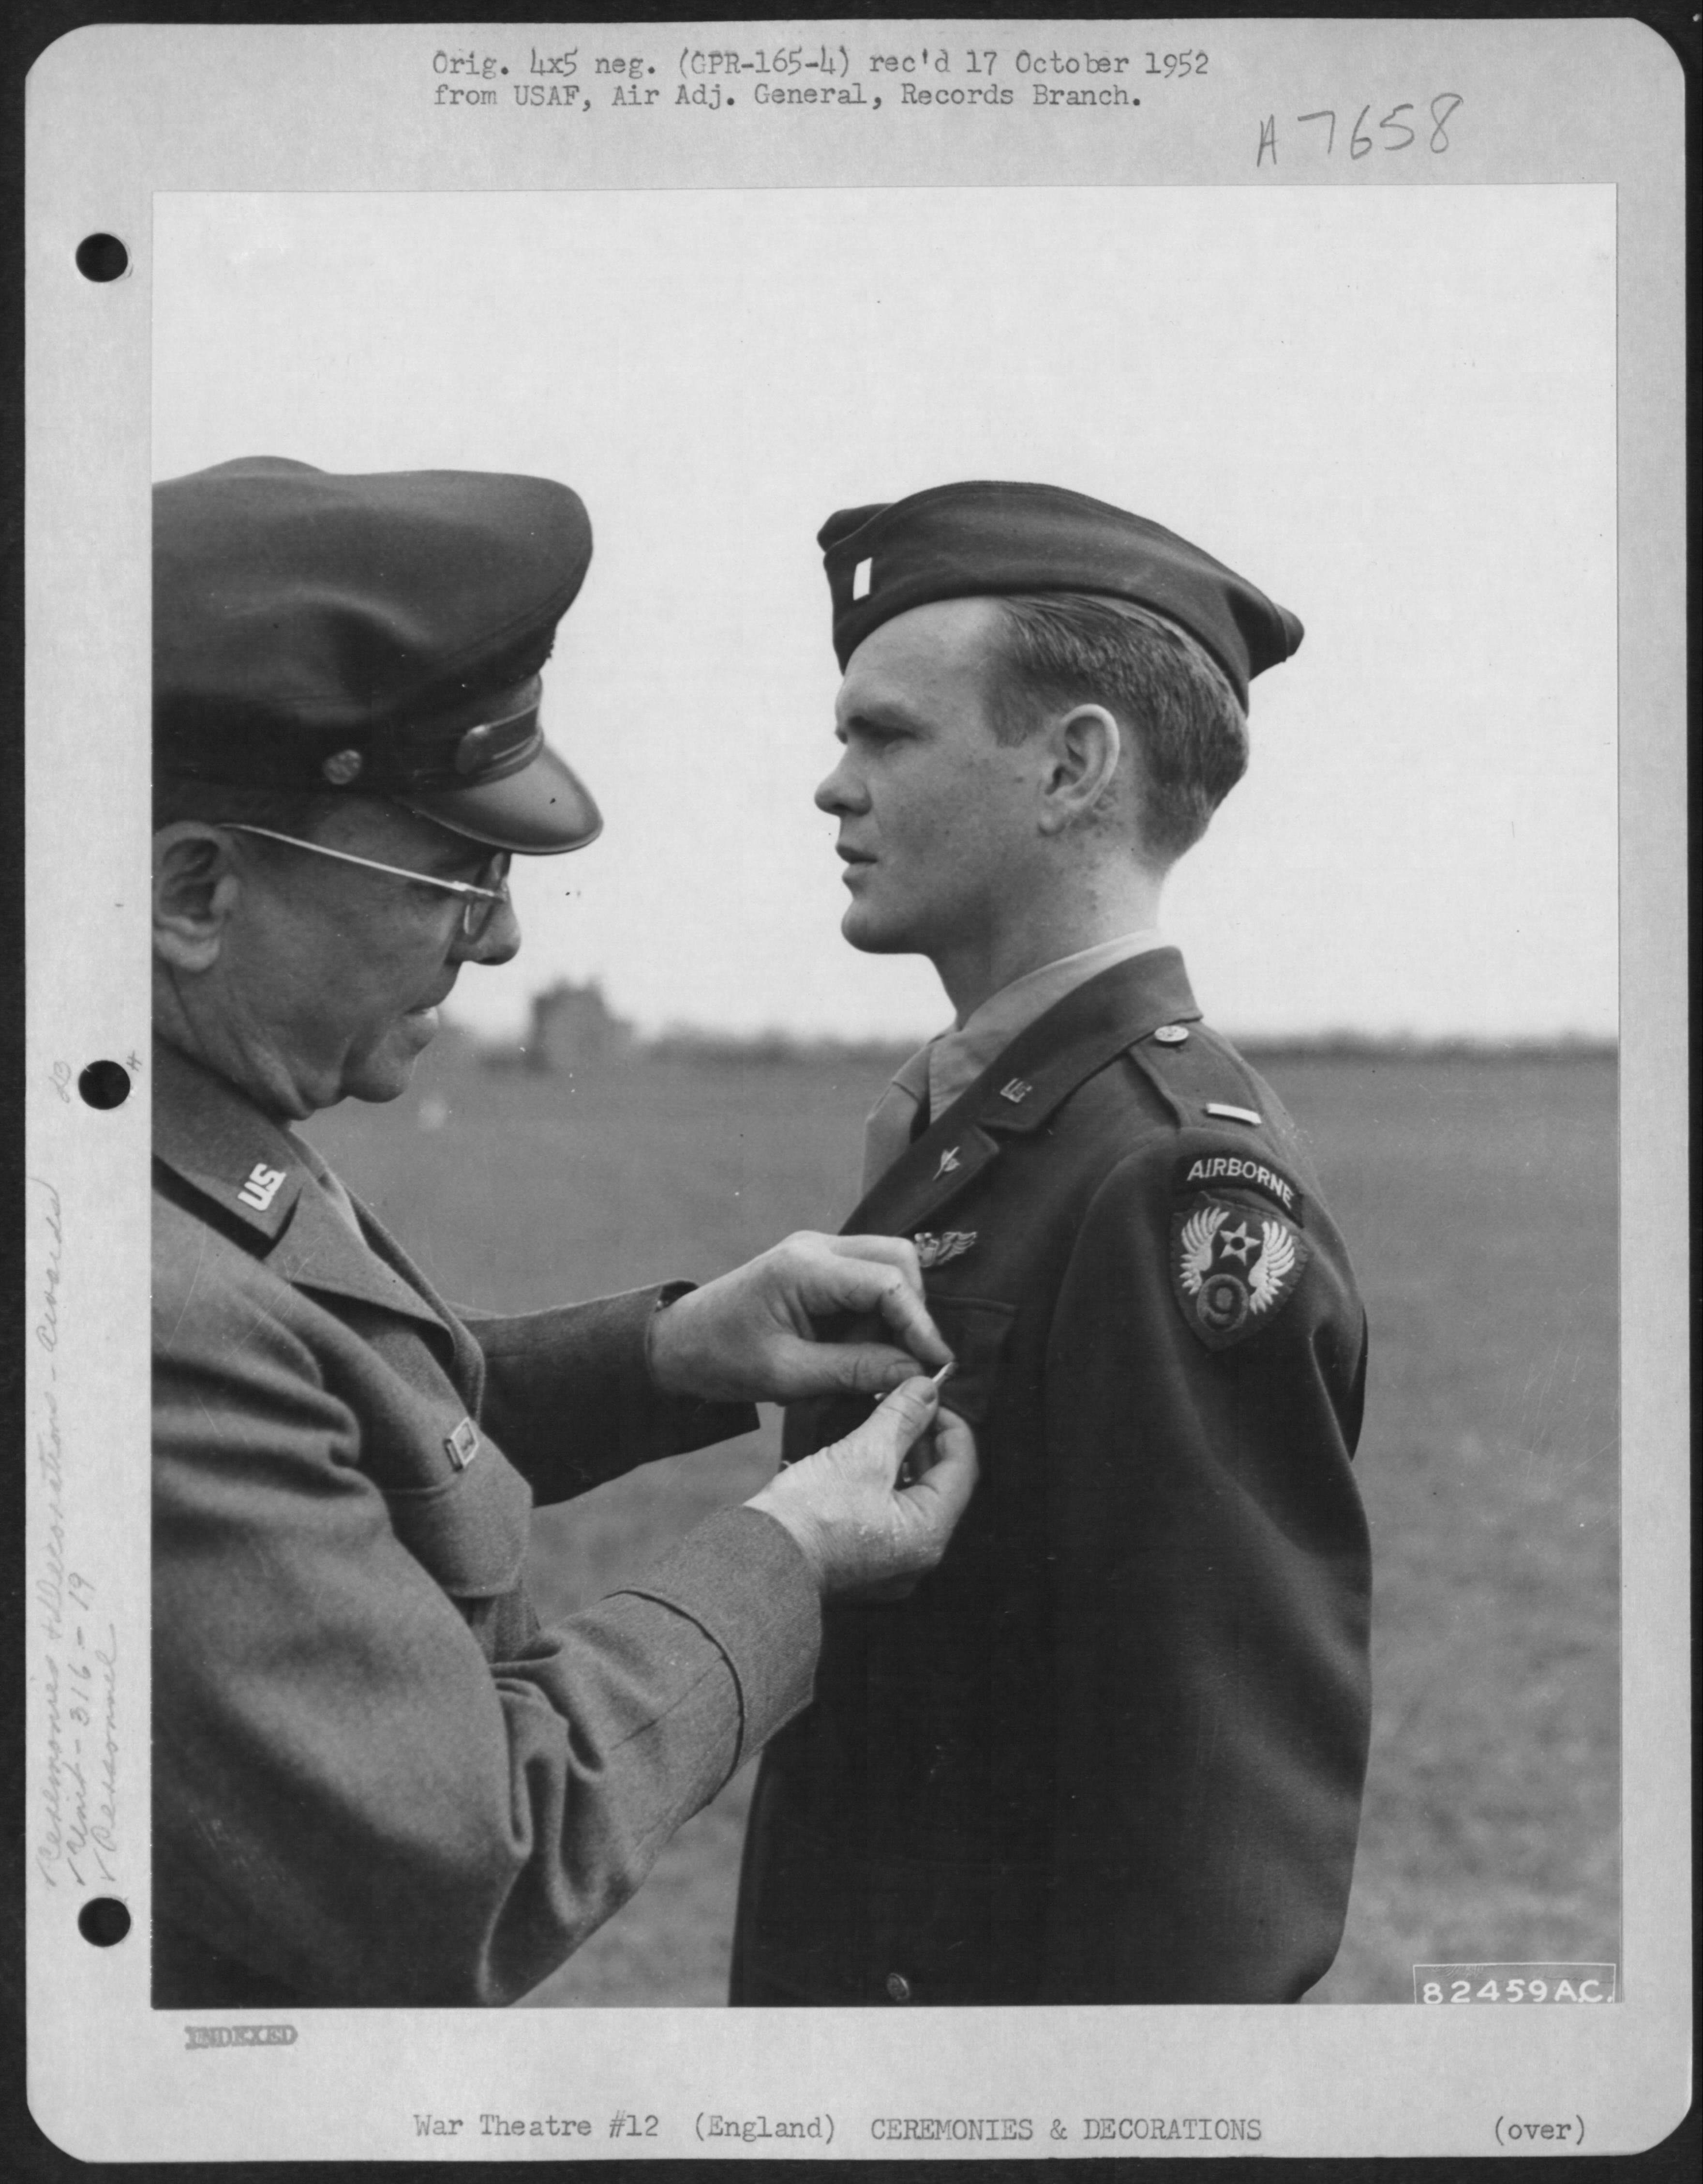
1st Lt. Woodrow V. Timo, 316th Troop Carrier Group, 19th Troop Carrier Command, receives the Distinguished Flying Cross from Lt. Gen Lewis H. Brereton during a ceremony at Cottesmore, England, 25 Apr 1945

Slide 30
